Slide 1

Capstone II
Academic Insights

Slide 2



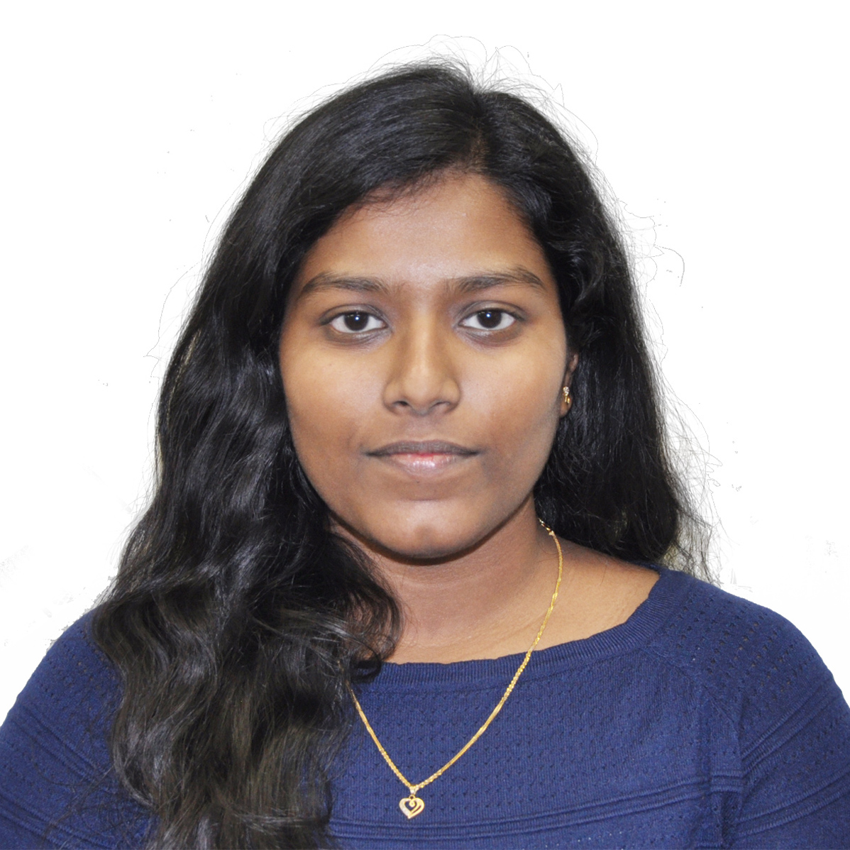
Academic Analysis using AI
Tech Lead
Nikhil Patel
nikhil.patel3@dcmail.ca
100799060
Developer
Parth Shah
parth.shah2@dcmail.ca
100799064
Developer
Harsh Patel
harshrajnikant.patel1@dcmail.ca
100800197
Developer
Amulya Pedapudi
amulya.pedapudi@dcmail.ca
100808959
Research

Slide 3
Project Description
Real time Interaction of student and professor made easy with a chatbot
Student Doubts can be solved by the chat bot or professor depending on the level of details required in the answer.
Insight can be presented to professor.

Slide 4
Chat Bot
Manage student and professor conversations.
Questions can be answered by chat bot
If the question found out of league than chat bot will lead to professor.

Slide 5
Insights can be presented?
Questions Raised by students : Insights like Frequency of questions, type of questions category, etc.
Professor rating based on polling
Active student
Member details

Slide 6
PRELIMINARY SCOPE
PRODUCT | Chatbot for academic insights
OBJECTIVE | -Creating more communication between the professor and students. -Interaction can be convenient and rapid. -Improving academic performance of the students.
COST | -Resources are open-source web frameworks and platforms -Server free of cost for deployment and storage.
TECHNOLOGY | Natural Language Processing SQL database Django framework & HTML, CSS and Bootstrap templates. Python libraries like spaCy, PyNLPl, NLTK, DeepPavlov, rasa-nlu. AWS Server for deployment
CONSTRAINTS | Privacy concerns and level of personalized questions (by students)

Slide 7
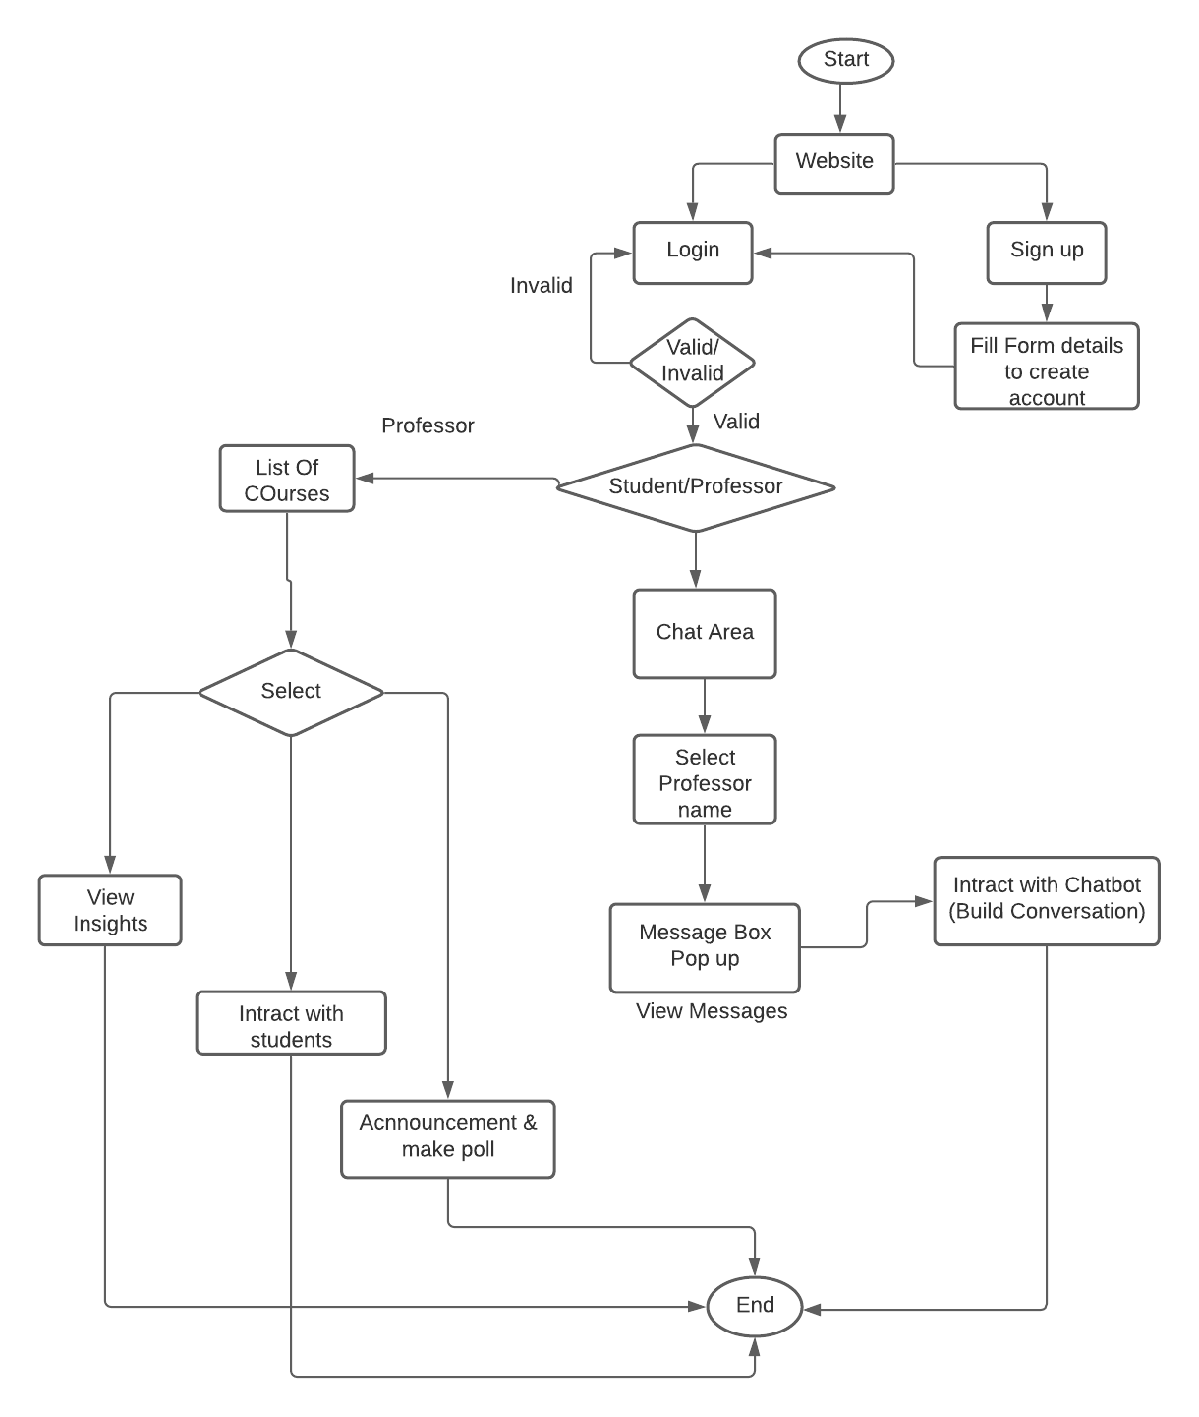




Flow Chart
For student
student

Slide 8
Database Structure
college_detail database: Emai-id Student/professor Password Course
Message Dataset: Text Categories of question Subcategory Email-id from Email-id to Question/ answer Time-stamp
Announcement: Email-id from Text Poll information Time-stamp
Chat bot : Intent Entity Linking between intent

Slide 9
USE CASES
Gretting with the students
Categorizing the questions
Showing professor questions based on different categories
Generating analysis from the database for professor to help in decision making
Answering the general questions of students using chatbot itself.

Slide 10


Future Scope
Mapping frequently asked question with answer
Chatbot can search google engine for research paper to answer question asked by student.
Using keyword differentiate question into categories.

Slide 11
Thank You

